Slide 1


Zulfikhar Ali
6/12/2023

Slide 2

Outline
Executive Summary
Introduction
Methodology
Results
Conclusion
Appendix

Slide 3
Executive Summary
Summary of methodologies
The research attempts to identify the factors for a successful rocket landing. To make this determination, the following methodologies were used:
Collect data using SpaceX REST API and web scraping techniques.
Wrangle data to create success/fail outcome variable
Explore data with data visualization techniques, considering the following factors:
payload, launch site, flight number and yearly trend
Analyze the data with SQL, calculating the following statistics:
total payload, payload range for successful launches, and total number of successful and failed outcome
Explore launch site success rates and proximity to geographical markers
Visualize the launch sites with the most success and successful payload ranges
Build Models to predict landing outcomes using logistic regression, support vector machine (SVM), decision tree, and K-nearest neighbor (KNN)
Results
Exploratory Data Analysis
Launch success improved over time
KSC LC 39A has highest success rate among landing sites
Orbits ES-L1, GEO, HEO, and SSO have 100% success rate
Visualization/Analytics
Most launch sites are near the equator, and all are close to the coast
Predictive Analytics
All models performed similarly on the test set.
Decision tree model slightly outperformed

Slide 4
Introduction
Background
Objective: Predicting successful landing of Falcon 9 first stage
Cost Estimation Importance: Falcon 9 launch cost ($62 million) significantly lower than competitors' ($165 million)
Cost advantage: SpaceX's reuse of first stage enables cost reduction and competitive pricing
Relevance: Determining landing success for estimating launch cost in bidding against SpaceX
Explore
Factors influencing first stage landing success:
Payload mass
Launch site
Number of flights
Orbits
Analysis of the rate of successful landings over time
Identification of the best predictive model for Falcon 9 first stage successful landing through binary classification

Slide 5

Section 1

Slide 6
Methodology
Executive Summary
Data collection methodology:
Collect data using SpaceX REST API and Web Scraping Techniques
Perform data wrangling
Filter data, handle missing values and apply one-hot encoding to prepare the data for analysis and modeling
Perform exploratory data analysis (EDA) using visualization and SQL
Perform interactive visual analytics using Folium and Plotly Dash
Perform predictive analysis using classification models
Build classification models and tune to find best model and parameters

Slide 7
Data Collection
SpaceX REST API
Data collected from SpaceX REST API: https://api.spacexdata.com/v4
Data includes information about the rocket used, payload delivered, launch specifications, landing specifications, and landing outcome
Web Scraping
Data collected using Beautiful Soup Python Package to parse the Wikipedia page titled "List of Falcon 9 and Falcon Heavy launches"
Information appended to data set using rocket ID and then normalized to csv

Slide 8
Data Collection – SpaceX API
SpaceX REST API Call
Rockets
Launchpads
Payloads
Cores
Past Flights
Filter to Falcon 9
Final Dataset Exported to CSV
Endpoints
Replace Missing Payload Mass with averages
GitHub Notebook Link

Slide 9

Data Collection - Scraping
SpaceX Wikipedia Page
Dates
Booster Versions
Landing Status
Payload Mass
Launch Site
Parse Tables into DataFrame
DataFrame Exported to CSV
Extract following html tables
Orbits
Flight Number
GitHub Notebook Link

Slide 10
Data Wrangling
Unfiltered Data
Missing Values
Data Types
Launches per Site
Count of each Orbit
Create Dependent Variable Column: Binary Landing Outcome Column
DataFrame Exported to CSV
EDA and Check for the following
Calculate Mission Outcome per Orbit type
Process of gathering, cleaning, transforming, and organizing raw data into a structured and usable format for analysis and modeling
GitHub Notebook Link

Slide 11
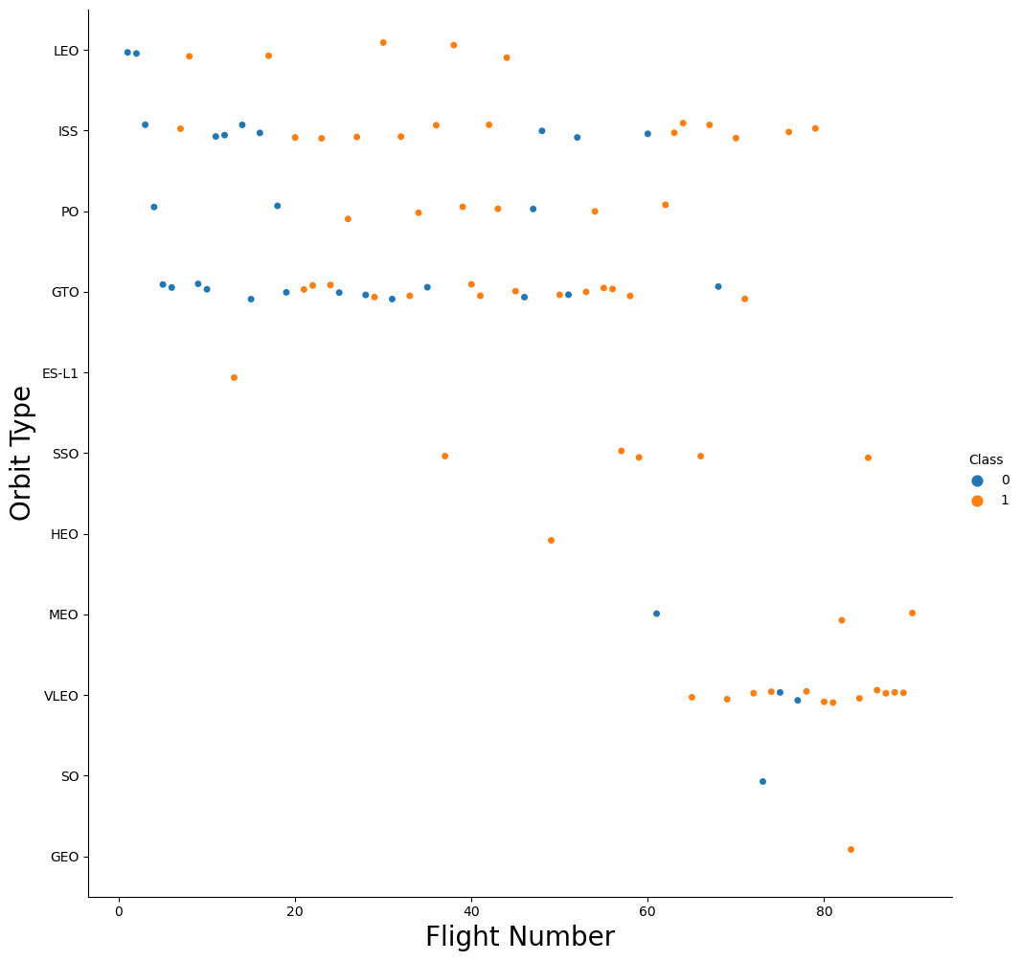
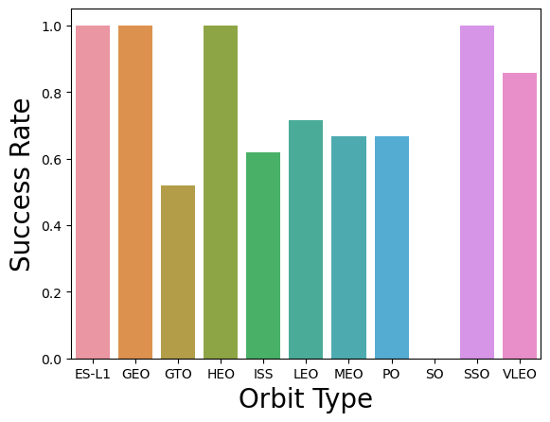
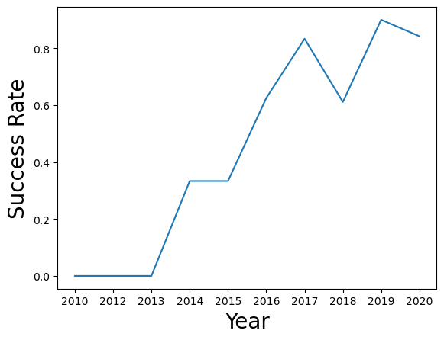
EDA with Data Visualization
Relationship between the following attributes:
Flight Number vs.
Payload Mass (kg), Launch Site
Payload Mass (kg) vs.
Launch Site, Orbit type
Success Rate and Yearly Success Rate Trend
GitHub Notebook Link

Slide 12
EDA with SQL
Performed following queries for better understanding of dataset:
Records where launch sites begin with the string ‘CCA’
Total payload mass carried by booster launched by NASA (CRS)
45596.0 kg
Booster Version F9 v1.1 average payload mass carried
2928.4 kg
Date first successful landing outcome (ground pad)
Boosters with successful landing in drone ship with payload mass between 4000 – 6000 kg
Total Successful/Failure mission
100/1 ratio
Booster Versions that carried the maximum payload mass
2015's failed Landing Outcomes in drone ship, their booster versions, and launch sites names
Rank the count of landing outcomes or success between 2010-06-04 and 2017-03-20
Drone ship had the most (and same number of) successful/failed landing outcomes
Github Notebook Link

Slide 13
Build an Interactive Map with Folium
To visualize the launch data into an interactive map. We took the latitude and longitude coordinates at each launch site and added a circle marker around each launch site with a label of the name of the launch site.
The dataframes launch_outcomes (failure, success) were assigned to classes 0 and 1 with Red and Green markers on the map in MarkerCluster()
Haversine’s formula to calculate the distance of the launch sites to various landmarks to find the answers to the questions:
How close are the launch sites to railways, highways, and coastlines?
How close are the launch sites to nearby cities?
Github Notebook Link

Slide 14
Build a Dashboard with Plotly Dash
We built an interactive dashboard with Plotly Dash, which allows the user to play around with the data as they need.
Dropdown List with Launch Sites
Allow users to select all launch sites or a certain launch site Dashboard with Plotly Dash.
Pie Chart Showing Successful Launches
Allow users to see successful and unsuccessful launches as a percentage of the total.
Payload Mass Range Slider
Allow user to select payload mass range.
Scatter Chart Showing Payload Mass vs. Success Rate by Booster Version
Allow users to see the correlation between Payload and Launch Success.
Github Notebook Link

Slide 15
Model Evaluation
Plot Confusion Matrix
Model Improvments
Build Model
Load, transform and split dataset
Choose ML type
Set parameters and algorithms to GridSearchCV
Check each model's accuracy
Tune each algorithms's hyperparameters
Find Best Model
Use Feature Engineering
Model with best accuracy score
Tune Algorithm (if necessary)
Predictive Analysis (Classification)
Github Notebook Link

Slide 16
Results
3 main Categories:
Exploratory Data Analysis
Launch success has improved over time
KSC LC39A has the highest success rate among landing sites
Orbits ESL1, GEO, HEO, and SSO have a 100% success rate
Interactive/Visual Analytics
Most launch sites are near equator; all are close to coast
Launch sites:
Far enough, away from anything a failed launch can damage (city, highway, railway)
Close enough to bring people and material to support launch activities
Predictive Analytics
Decision Tree model was the best predictive model

Slide 17

Section 2

Slide 18
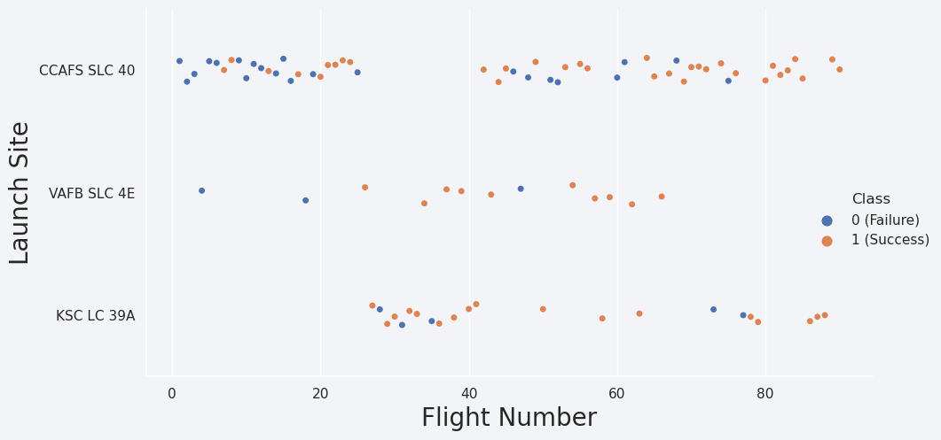
Flight Number vs. Launch Site
Later Flight numbers and success rate are ~correlated
Earlier Flights had lower success rate (Blue)
Later Flights had higher success rate (Orange)
CCAFS SLC 40: ~50% of launches & 60% success rate
KSC LC-39A and VAFB SLC 4E: 77%success rate

Slide 19
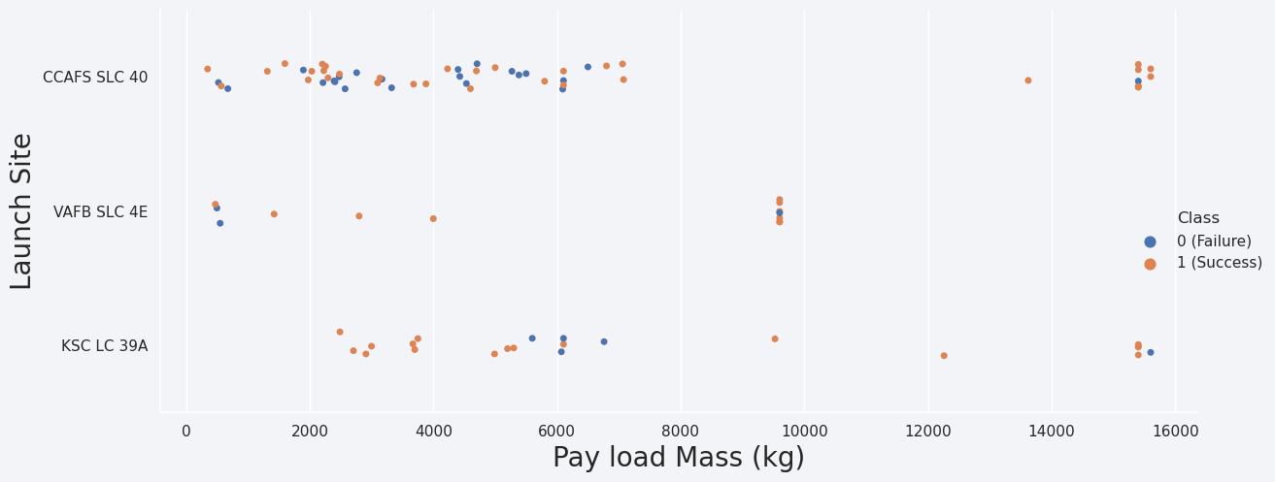
Payload vs. Launch Site
Typically, the higher the payload mass (kg), the higher the success rate
KSC LC 39A: 100% success rate for launches < 5,500 kg
VAFB SLC 4E: no rockets launched for heavy payload mass (> 10000 kg)

Slide 20
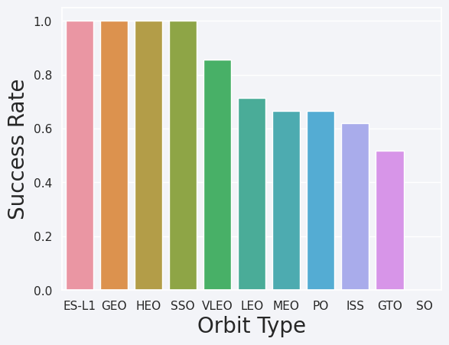
Success Rate vs. Orbit Type
100% Success Rate: ES L1, GEO, HEO and SSO
50%-80% Success Rate: GTO, ISS, LEO, MEO, PO
0% Success Rate: SO
Depper Analysis: Some orbits have only 1 occurrence (i.e., GEO, SO, HEO and ES-L1)
More data needed to see pattern or trend before we draw any conclusion

Slide 21
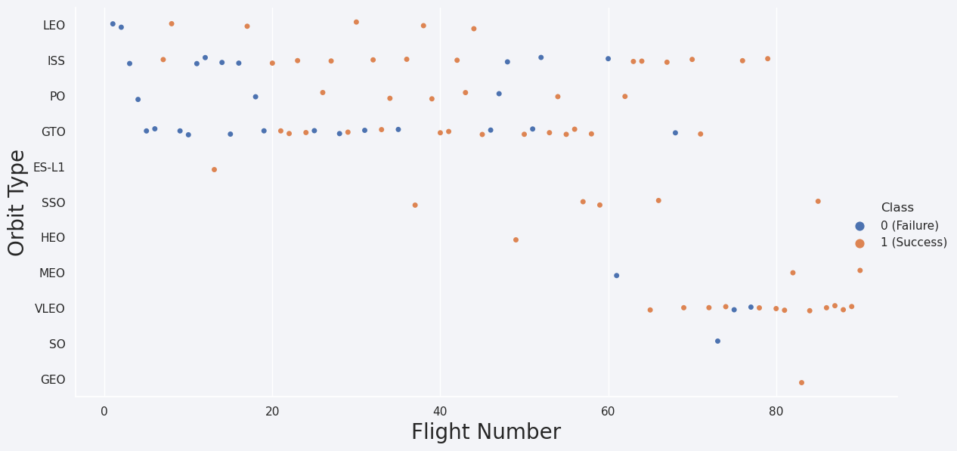
Flight Number vs. Orbit Type
Success rate typically increases with the number of flights for each orbit
Relationship is highly apparent for the LEO orbit
GTO orbit does not follow this trend

Slide 22
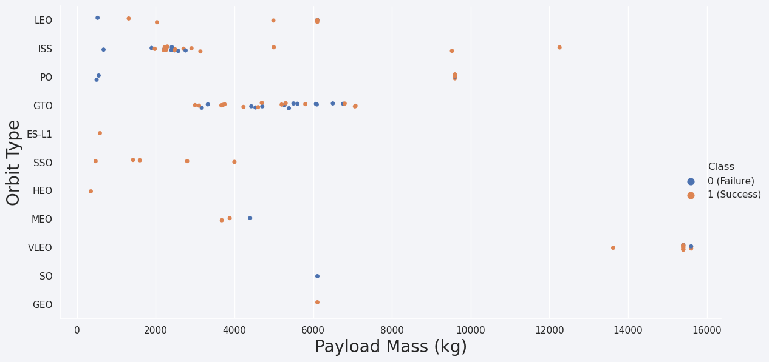
Payload vs. Orbit Type
Heavy payloads better with LEO, ISS and PO orbits
GTO orbit has mixed success with heavier payloads
SO, GEO and HEO orbit need more dataset to see any pattern or trend

Slide 23
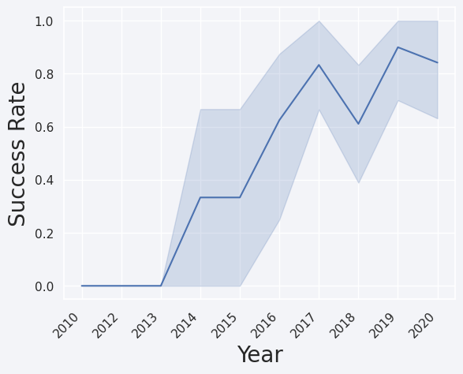
Launch Success Yearly Trend
Success rate
Improved from 2013 - 2017 and 2018 2019
Decreased from 2017 - 2018 and 2019 - 2020
Success rate has improved since 2013
If trend continues, steadily increase until reaching 1/100% success rate

Slide 24
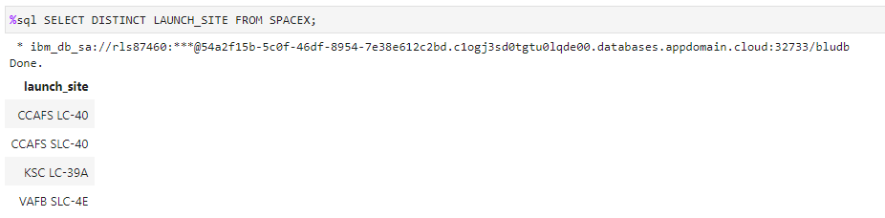
All Launch Site Names
Used DISTINCT to show only unique launch sites from the SpaceX data

Slide 25
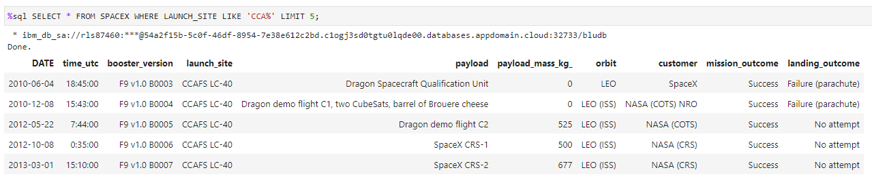
Launch Site Names Begin with 'CCA'
Used the query below to display 5 records where launch sites begin with `CCA`

Slide 26
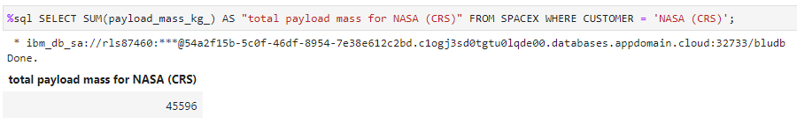
Total Payload Mass
Total Payload Mass carried by boosters from NASA

Slide 27
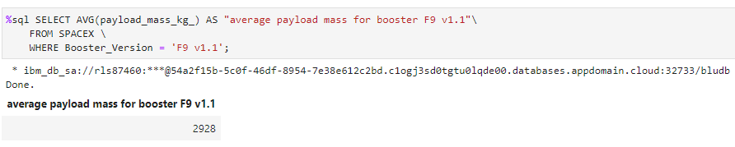
Average Payload Mass by F9 v1.1
Average payload mass carried by booster version F9 v1.1

Slide 28
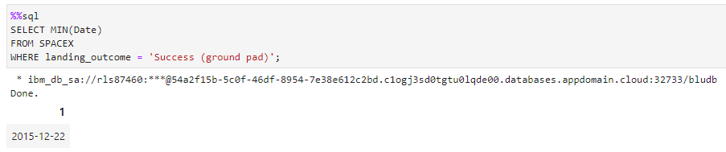
First Successful Ground Landing Date
First Successful landing outcome on ground pad

Slide 29
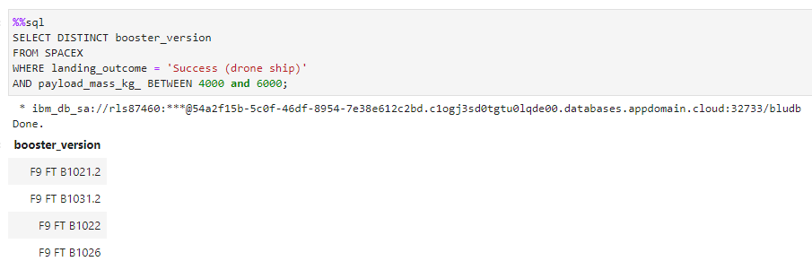
Successful Drone Ship Landing with Payload between 4000 and 6000
Boosters that Successfully landed on drone ship with Payload Mass between 4000 and 6000

Slide 30
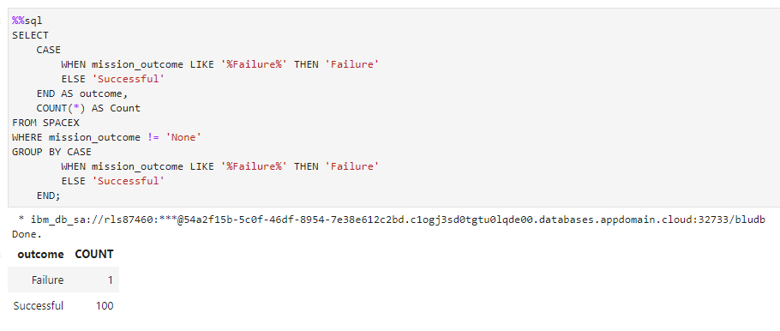
Total Number of Successful and Failure Mission Outcomes
Total Successful and Failed Mission Outcomes
used wildcard like ‘%’ to filter for WHERE Mission Outcome was a success or a failure

Slide 31
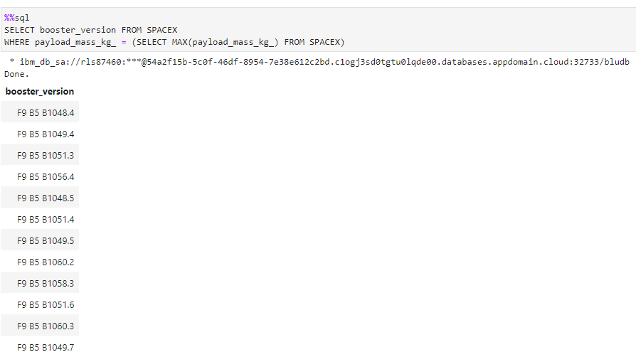
Boosters Carried Maximum Payload
Booster that carried the Maximum Payload Mass

Slide 32
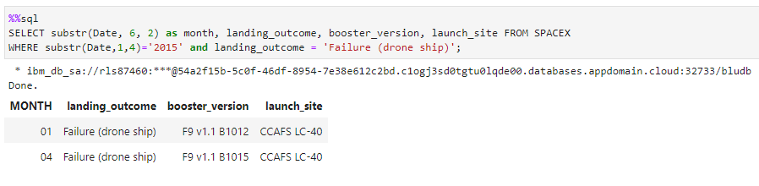
2015 Launch Records
2015 Failed Landing Outcomes in drone ship:
Showing month, landing outcome, booster version and launch site

Slide 33
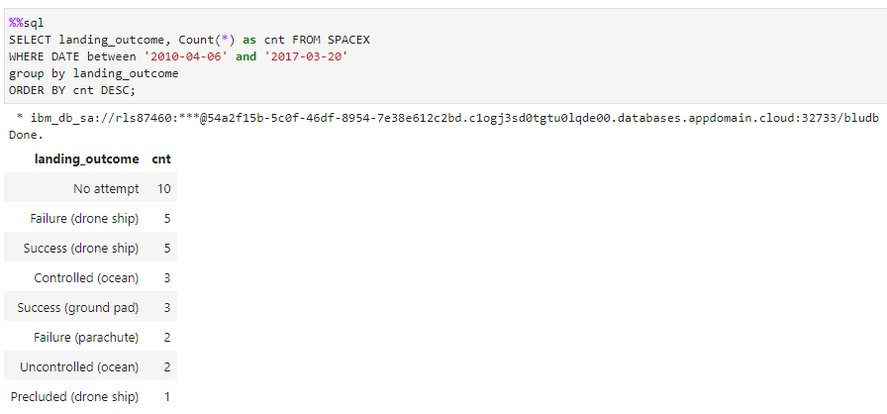
Rank Landing Outcomes Between 2010-06-04 and 2017-03-20
Count of Landing Outcomes between 2010-06-04 and 2017-03-20 Ranked (Descending Order)
e.g., Failure (drone ship) or Success (ground pad)

Slide 34

Section 3

Slide 35
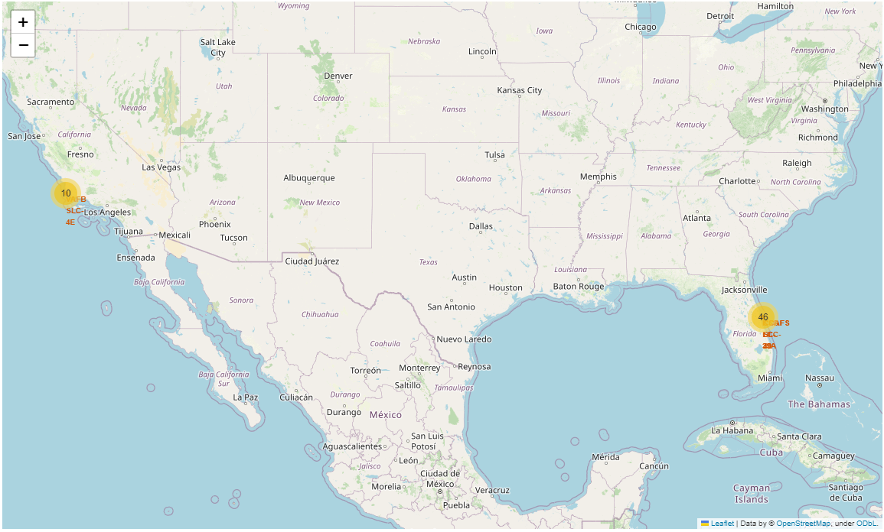
Launch Site
Near Equator: the closer the launch site to equator, the easier to launch to equatorial orbit, and the more help you get from Earth's rotation for a prograde trajectory
Rockets launched from sites near equator get additional boost due to the Earth's rotational speed
Helps save cost of putting extra fuel and boosters

Slide 36
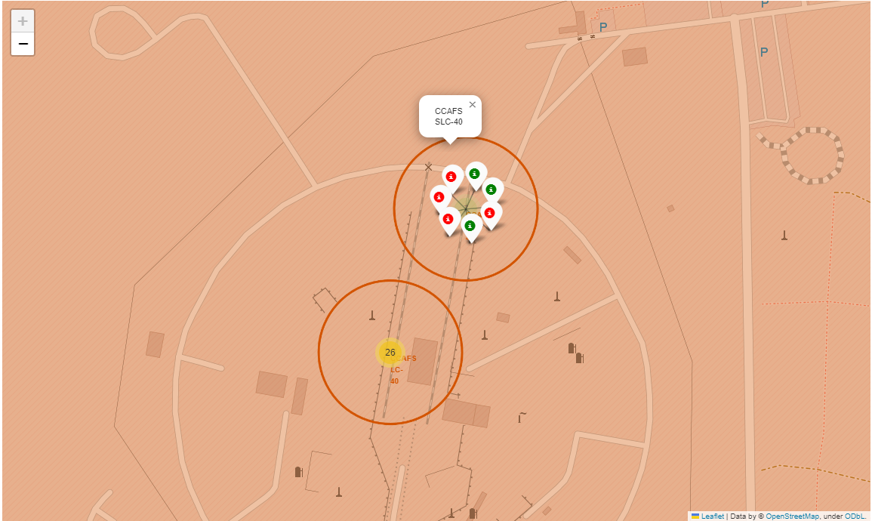
Launch Outcomes
Green markers for successful launches
Red markers for failed launches
CCAFS SLC 40: 3/7 success rate (i.e., 42.9%)

Slide 37
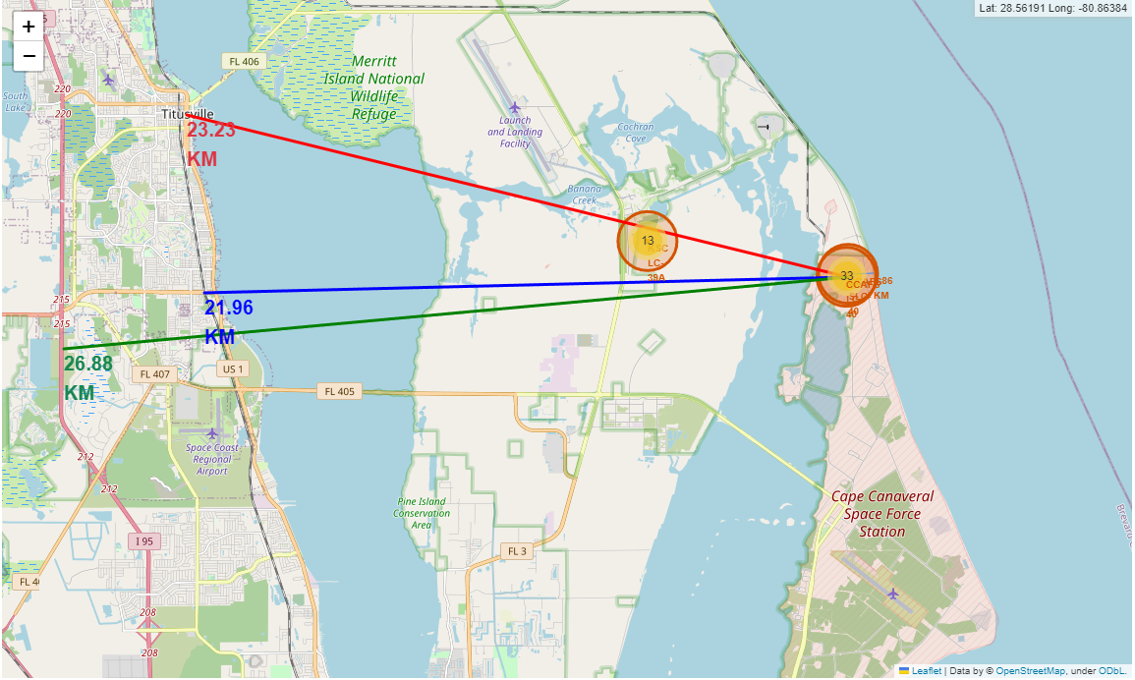
Distances to Proximities
Coasts: help ensure that spent stages dropped along launch path or failed launches don't fall on people or property
Safety/Security: exclusion zone required around launch site to keep unauthorized people away and safe
Transportation/Infrastructure and Cities: needs to be away from anything a failed launch can damage but still close enough to roads/rails/docks to bring people and material to and/or from it to support launch activities

Slide 38

Section 4

Slide 39
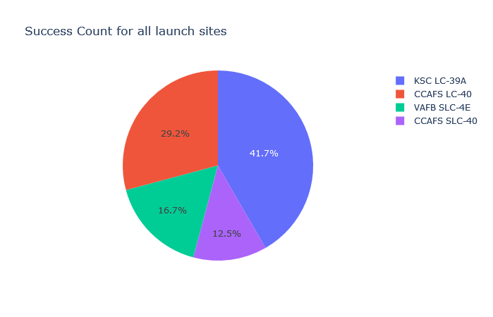
Launch Success by Site
Highest Success: KSC LC-39A
Lowest Success: CCAFS SLC-40

Slide 40
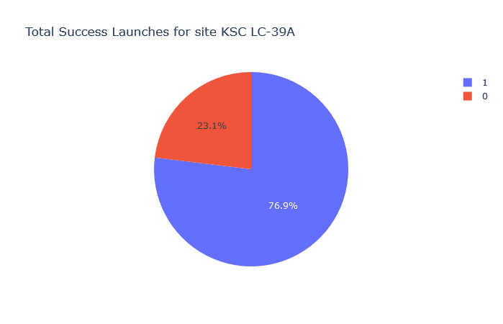
Launch Success (KSC LC-29A)
# of Launches
Success: 10
Failed: 3

Slide 41
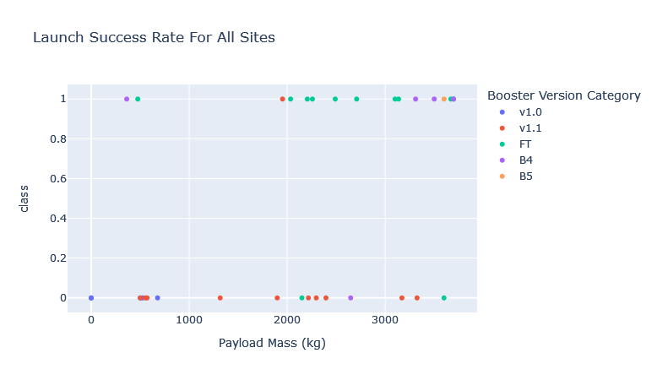
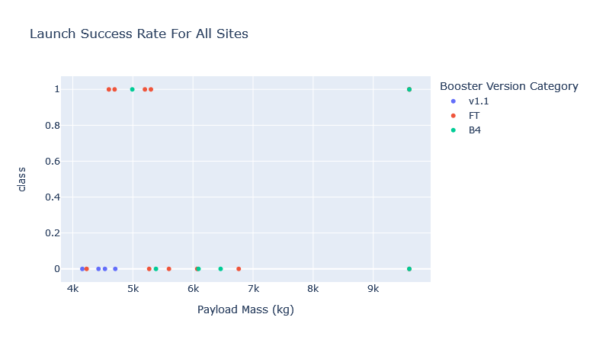
Payload Mass and Success
Success rate for low weighted payload is higher than heavy weighted payload
Payload Mass 0 – 4,000 kg
Payload Mass 4,000 – 10,000 kg

Slide 42

Section 5

Slide 43
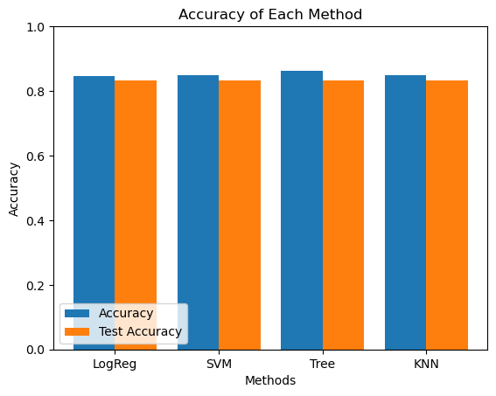
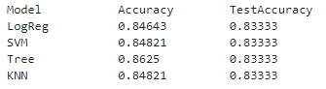
Classification Accuracy
All models produced ~87% accuracy on the test data
Decision tree performed the best (slightly) on the training data

Slide 44
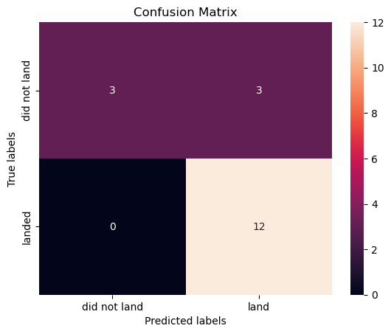
Confusion Matrix
Decision Tree
Distinguishes between different classes (i.e., Landed or Not)
False Positives (Type 1 Error): Major Problem
unsuccessful landing marked as successful landing by the classifier
Outputs:
12 True Positive (TP)
3 True Negative (TN)
3 False Positive (FP)
0 False Negative (FN)
Precision: TP/ (TP + FP) = .80
Recall: TP/ (TP + FN) = 1
F1-score: 2*(Precision * Recall)/ (Precision + Recall) = .89
Accuracy: (TP+TN)/ (TP + TN + FP + FN) = .833

Slide 45
Conclusions
Model Performance: Each performed similarly on the test set, with the decision tree model slightly outperforming
Equator: Most launch sites are near the equator for an additional natural boost due to the rotational speed of Earth
Helps save the cost of putting in extra fuel and boosters
Coast: All launch sites are close to the coast
Launch Success: Increases over time
KSC LC-39A: Has highest success rate among launch sites ~76.9%
Has a 100% success rate for launches less than 5,500 kg
Orbits: ES L1, GEO, HEO, and SSO have 100% success rate
Payload Mass: Across all launch sites, the higher the payload mass (kg), the higher the success rate

Slide 46
Appendix
All Python code, SQL queries, charts, Notebook outputs, and data sets are available at the following GitHub Repository:
SpaceX First Stage Launch GitHub Repository

Slide 47


